Slide 1
Internetworking Models
When networks first came into being, computers could typically communicate only with computers from the same manufacturer.
  For example, companies ran either a complete DECnet solution or an IBM solution—not both together.
In the late 1970s, the Open Systems Interconnection (OSI) reference model was created by the International Organization for Standardization (ISO) to break this barrier.
The OSI model was meant to help vendors create interoperable network devices and software in the form of protocols so that different vendor networks could work with each other.

Slide 2
Internetworking Models
The OSI model is the primary architectural model for networks.
It describes how data and network information are communicated from an application on one computer through the network media to an application on another computer.
The OSI reference model breaks this approach into layers.

Slide 3
Reference model
A reference model is a conceptual blueprint of how communications should take place.
It addresses all the processes required for effective communication and divides these processes into logical groupings called layers.
When a communication system is designed in this manner, it’s known as layered architecture.
Think of it like this: You and some friends want to start a company. One of the first things you’ll do is sit down and think through what tasks must be done, who will do them, the order in which they will be done, and how they relate to each other. Ultimately, you might group these tasks into departments. Let’s say you decide to have an order-taking department, an inventory department, and a shipping department. Each of your departments has its own unique tasks, keeping its staff members busy and requiring them to focus on only their own duties.

Slide 4
Advantages of Reference Models
The OSI model is hierarchical, and the same benefits and advantages can apply to any layered model. The primary purpose of all such models, especially the OSI model, is to allow different vendors’ networks to interoperate.
Advantages of using the OSI layered model include, but are not limited to, the following:
It divides the network communication process into smaller and simpler components, thus aiding component development, design, and troubleshooting.
It allows multiple-vendor development through standardization of network components.
It encourages industry standardization by defining what functions occur at each layer of the model.
It allows various types of network hardware and software to communicate.
It prevents changes in one layer from affecting other layers, so it does not hamper development.

Slide 5
OSI Reference Model
One of the greatest functions of the OSI specifications is to assist in data transfer between disparate hosts—
meaning, for example, that they enable us to transfer data between a Unix host and a PC or a Mac
OSI has seven different layers, divided into two groups.
The top three layers define how the applications within the end stations will communicate with each other and with users.
The bottom four layers define how data is transmitted end to end.

Slide 6
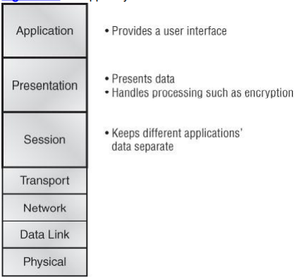
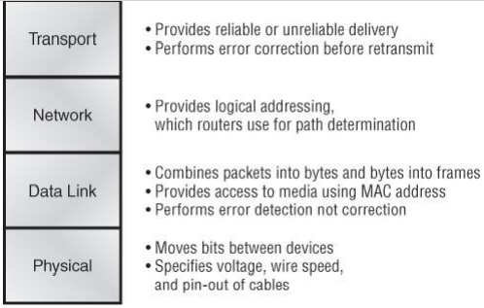

Slide 7
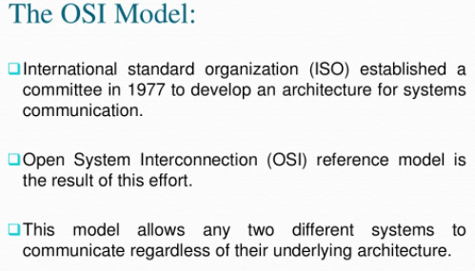

Slide 8
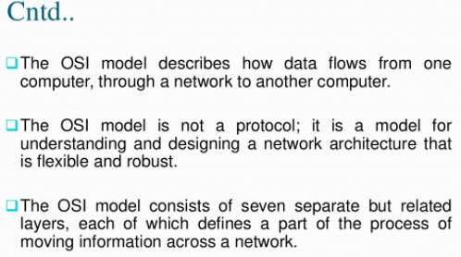
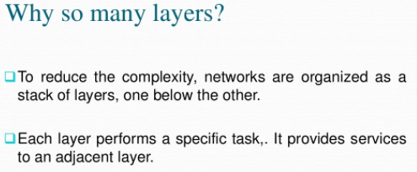

Slide 9
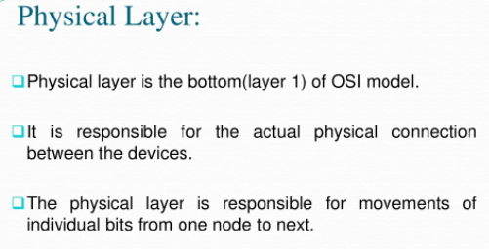

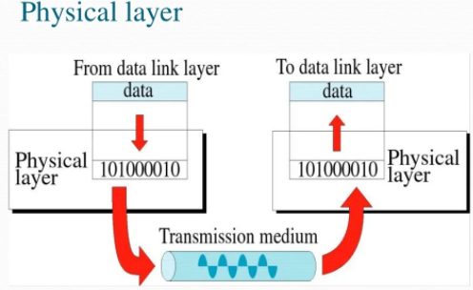

Slide 10
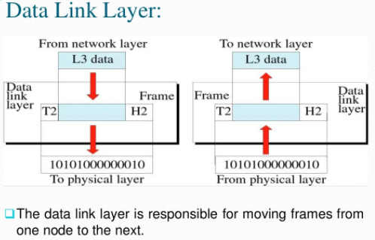
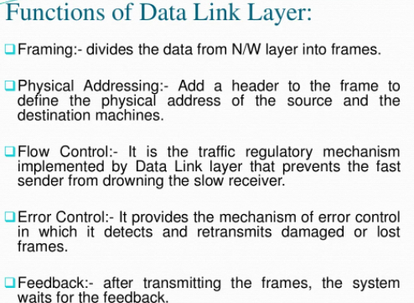

Slide 11
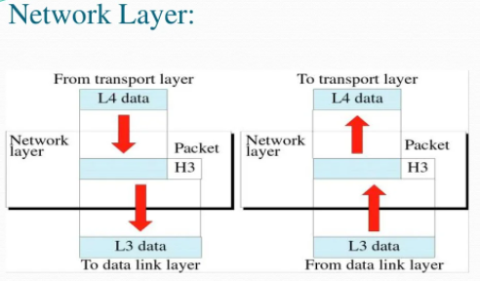
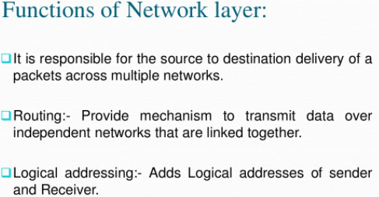

Slide 12
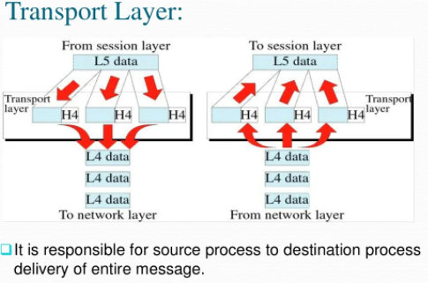
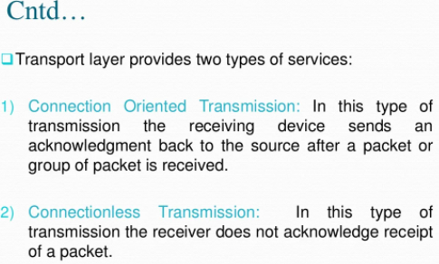
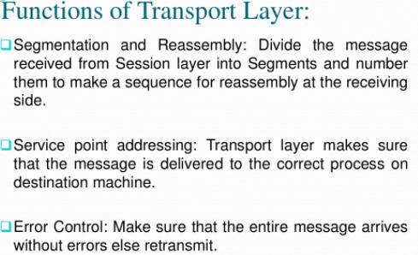

Slide 13
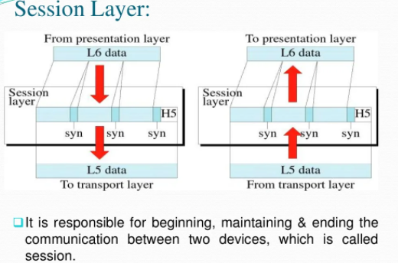
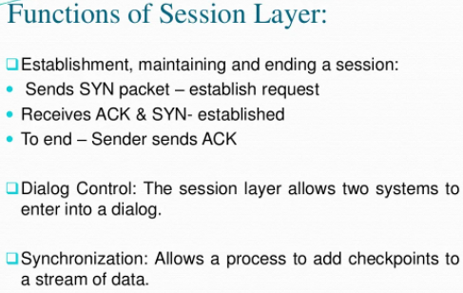

Slide 14
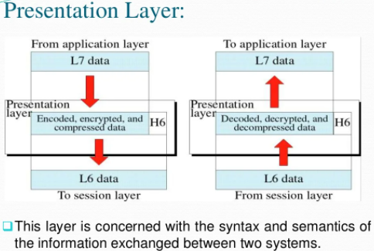
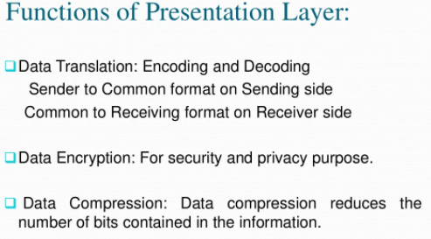

Slide 15
